Slide 1
Deep Learning Seminar Day-3

Slide 2
Recurrent Neural Networks (RNN) concepts
What’s new with Recurrent Nets?
They allow us to operate over sequences of vectors
Applications areas are broad:
Signals: video, speech, sensors,….
Time series: financial series, log messages,..
Sequence of characters: Natural Language Processing,…
RNN can use sequences in the input, the output, or both.

Slide 3

Recurrent Neural Networks (RNN) concepts
Image
description
using text
Emotion
Recognition
Language
Model
Machine
Translation
Video frame
labelling
Phoneme
Recognition

Slide 4
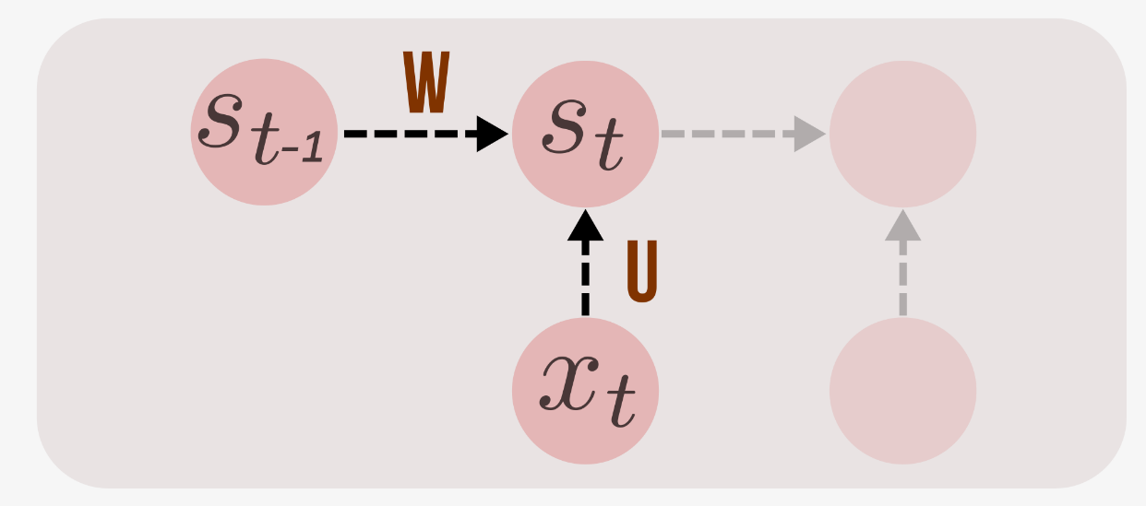
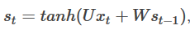
http://suriyadeepan.github.io/2017-02-13-unfolding-rnn-2/
RNNs combine the input vector with their state vector with a fixed (but learned) function to produce a new state vector.

Slide 5
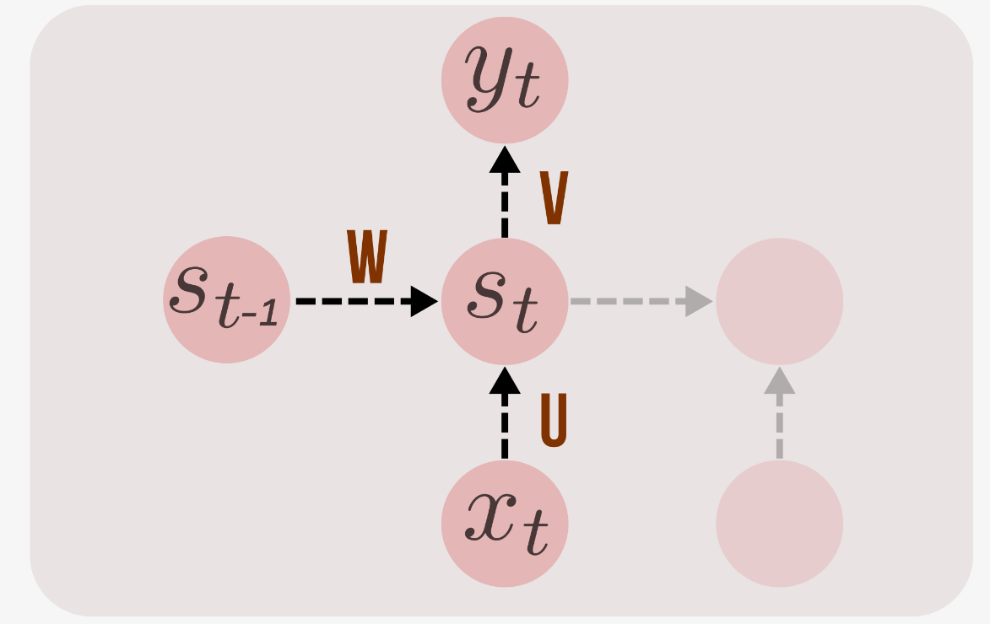
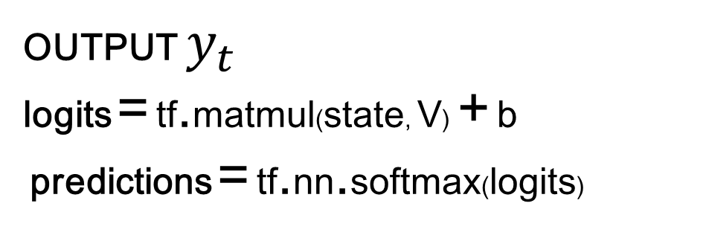
OUTPUT $y_{t}$
logits = tf.matmul(state, V) + b
predictions = tf.nn.softmax(logits)

Slide 6
RNN essentially describe programs:
inputs + some internal variables.
In fact, it is known that RNNs are Turing-Complete in the sense that they can to simulate arbitrary programs (with proper weights).
…path to AI??
…. But “ forget I said anything.”
Andrej Karpathy
http://karpathy.github.io/2015/05/21/rnn-effectiveness

Slide 7
Written Memories: Understanding, Deriving and Extending the LSTM
http://r2rt.com/written-memories-understanding-deriving-and-extending-the-lstm.html

Slide 8
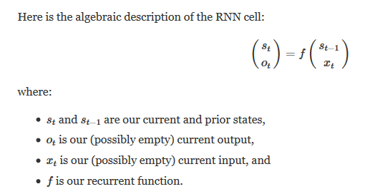

Slide 9
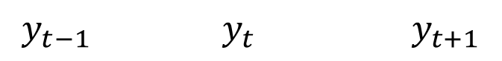
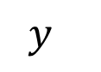
$${ y}_{}$$
$${y_{t−1}{ y}_{t} y}_{t+1}$$

Slide 10
Output sequence
$${y_{t−1}{ y}_{t} y}_{t+1}………$$
Input sequence
$${x_{t−1}{ x}_{t} x}_{t+1}………$$

Slide 11
……
State
sequence!
$${s_{t−1}{ s}_{t} s}_{t+1}………$$

Slide 12
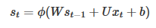
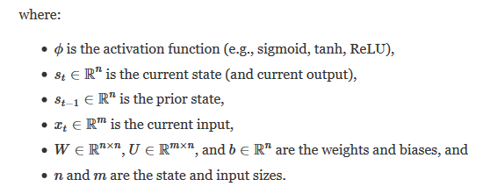
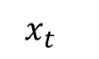
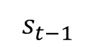
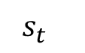
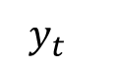
$${{ y}_{t}}_{}$$
$${{ s}_{t}}_{}$$
$${{ s}_{t−1}}_{}$$
$${{ x}_{t}}_{}$$

Slide 13
TRAINING RNN: W, U, V ?
BPTT: Backpropagation Through Time
Truncated

Slide 14
Backpropagation Through Time (BPTT)
Because the parameters are shared by all time steps in the network
The gradient at each output depends not only on the calculations of the current time step, but also the previous time steps.
http://www.wildml.com/2015/09/recurrent-neural-networks-tutorial-part-2-implementing-a-language-model-rnn-with-python-numpy-and-theano/

Slide 15
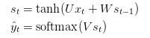
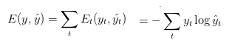

Backpropagation Through Time (BPTT)
Cross entropy loss:
The output value does depend on the state of the hidden layer,
which depends on all previous states of the hidden layer
and thus, all previous inputs

Slide 16
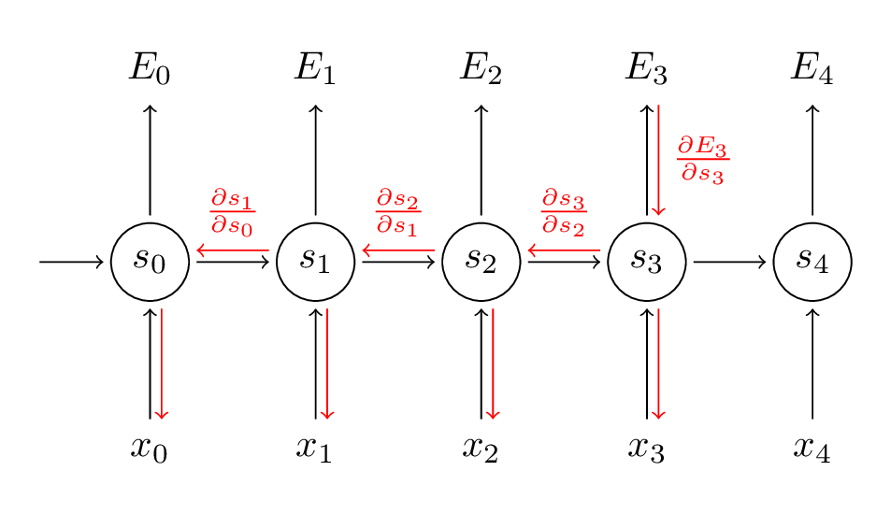
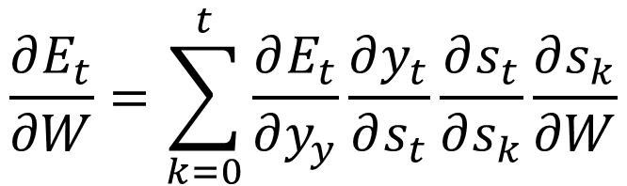
Backpropagation Through Time (BPTT)
But the recurrent net can be seen as a (very deep) feedforward net with shared weights
The forward pass builds up a stack of the activities of all the units at each time step.
The backward pass peels activities off the stack to compute the error derivatives at each time step.
After the backward pass we add together the derivatives at all the different times for each weight
$$\frac{∂E_{t}}{∂W}=\sum_{k=0}^{t}{\frac{∂E_{t}}{∂y_{y}}\frac{∂y_{t}}{∂s_{t}}\frac{∂s_{t}}{∂s_{k}}\frac{∂s_{k}}{∂W}}$$

Slide 17
Styles of Truncated Backpropagation
Tensorflow-style
num_steps

Slide 18
Vanishing gradient problem
In an RNN trained on long sequences (e.g. 100 time steps) the gradients can easily explode or vanish.
Led to the development of LSTMs and GRUs, two of the currently most popular and powerful models
http://www.wildml.com/2015/09/recurrent-neural-networks-tutorial-part-2-implementing-a-language-model-rnn-with-python-numpy-and-theano/

Slide 19
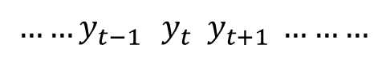
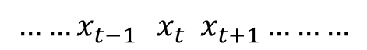
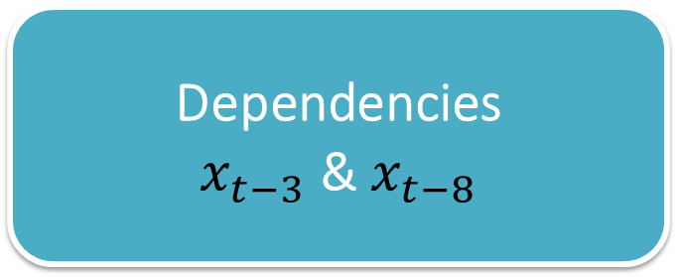
Simple Example: RNN for a Binary Sequence
http://r2rt.com/recurrent-neural-networks-in-tensorflow-i.html
$${{……y}_{t−1}{ y}_{t} y}_{t+1} ………$$
Output sequence
……
Dependencies
$x_{t−3}$ & $x_{t−8}$
Input sequence
50% 0 & 50% 1
……
$${{……x}_{t−1}{ x}_{t} x}_{t+1}………$$

Slide 20
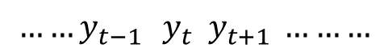
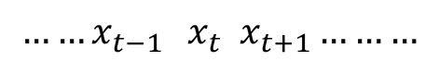
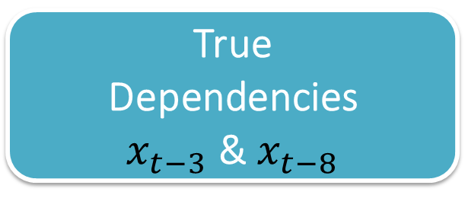
$${{……y}_{t−1}{ y}_{t} y}_{t+1} ………$$
Output sequence
……
True
Dependencies
$x_{t−3}$ & $x_{t−8}$
RNN
model
Input sequence
50% 0 & 50% 1
……
$${{……x}_{t−1}{ x}_{t} x}_{t+1}………$$
Expected cross entropy loss if the model:
- learns neither dependency: 0.661563238158
- learns first dependency: 0.519166699707
- learns both dependencies: 0.454454367449

Slide 21
We will start with a BasicRNNCell
MSTC_RNN_1.ipynb

Slide 22
First: dealing with data
Generate our binary sequences
Prepare for feeding data into the graph: from raw data to batches

Slide 23

Prepare for feeding data into the graph: from raw data to batches
Remember: Neural networks are trained by approximating the gradient of loss function using only a small subset of the data, also known as a mini-batch.

Slide 24
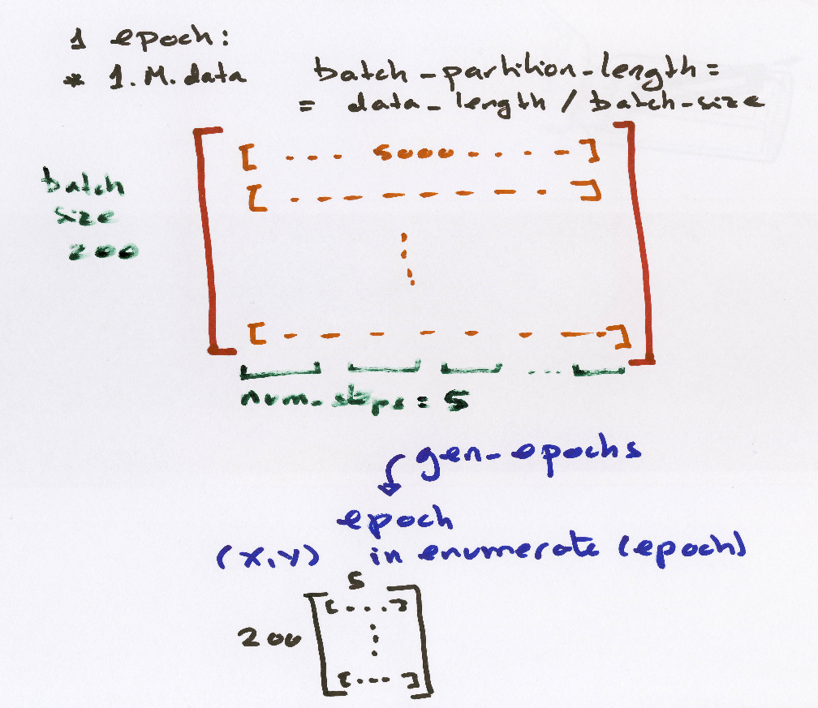
Prepare for feeding data into the graph: from raw data to batches
1M data
batch_size
200
num_steps=5
yield instead
of return
GENERATOR
def gen_epochs(n, num_steps):
def gen_batch(raw_data, batch_size, num_steps):
mini-batches

Slide 25
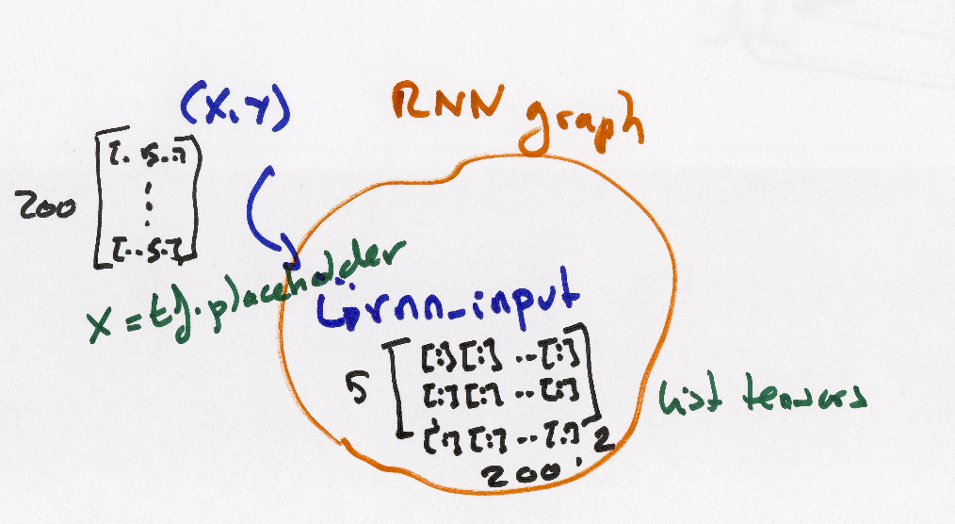
def train_network(num_epochs, num_steps, state_size=4, verbose=True):
…..
for idx, epoch in enumerate(gen_epochs(num_epochs, num_steps)):
for step, (X, Y) in enumerate(epoch):
sess.run([losses_last,total_loss,final_state,train_step],
feed_dict={x:X, y:Y, init_state:training_state})
x = tf.placeholder(tf.int32, [batch_size, num_steps], name='input_placeholder')

Slide 26
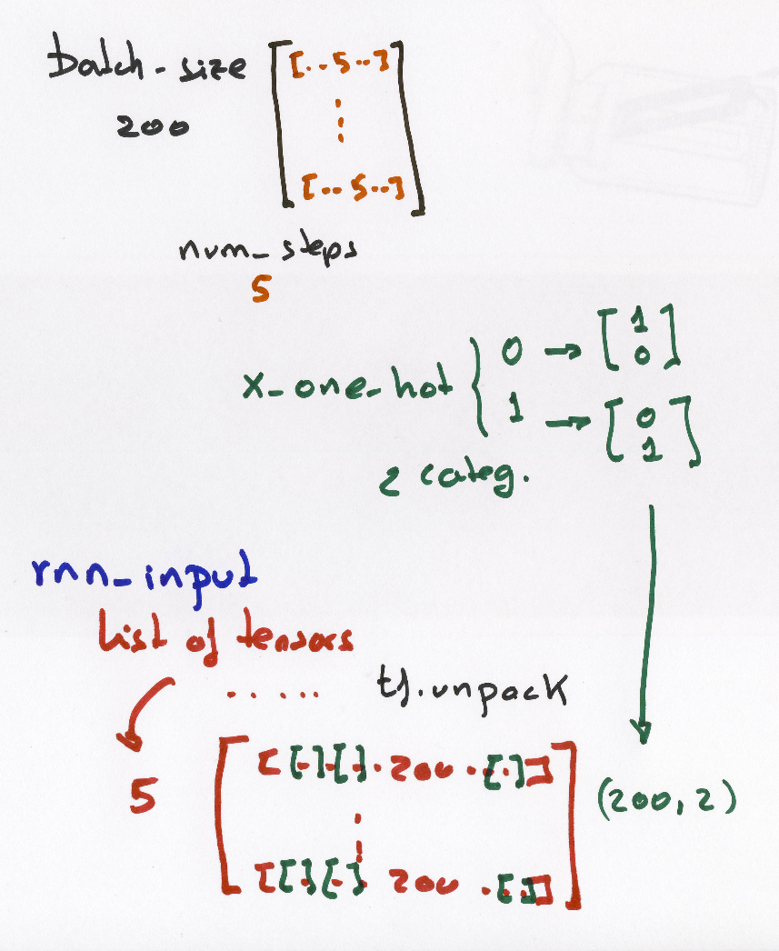
x_one_hot = tf.one_hot(tf.cast(tf.transpose(x, perm=[1, 0]), tf.int64), num_classes, 1,0)
rnn_inputs = tf.unpack(tf.cast(x_one_hot, tf.float32))

Slide 27
$${{ y}_{t}}_{}$$
$${{ s}_{t}}_{}$$
$${{ s}_{t−1}}_{}$$
$${{ x}_{t}}_{}$$

Slide 28
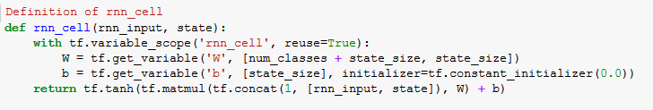
$${{ y}_{t}}_{}$$
$${{ s}_{t}}_{}$$
$${{ s}_{t−1}}_{}$$
$${{ x}_{t}}_{}$$
W includes W and U

Slide 29
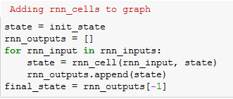
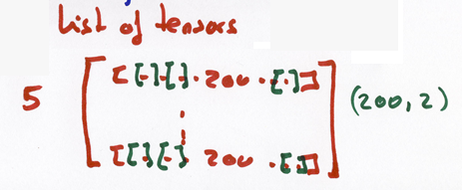
rnn_inputs
Processed as:
rnn_input

Slide 30
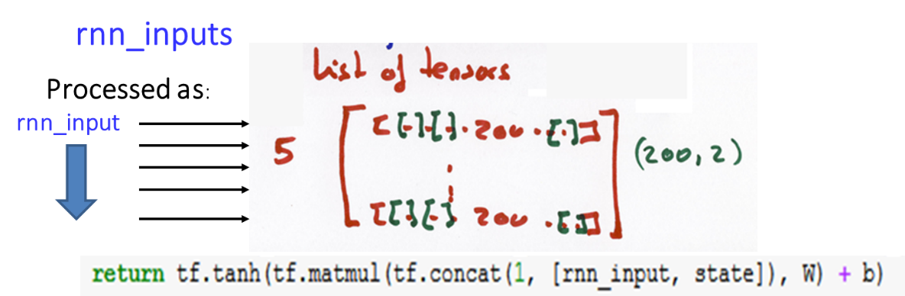
Styles of Truncated Backpropagation
state=
init_state
Tensorflow-style
num_steps

Slide 31
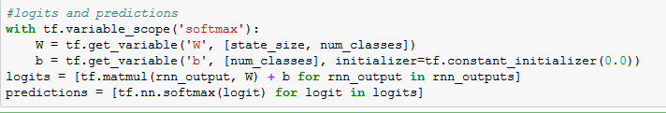
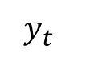
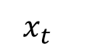
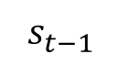
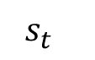
softmax
$${{ y}_{t}}_{}$$
$${{ s}_{t}}_{}$$
$${{ s}_{t−1}}_{}$$
$${{ x}_{t}}_{}$$

Slide 32
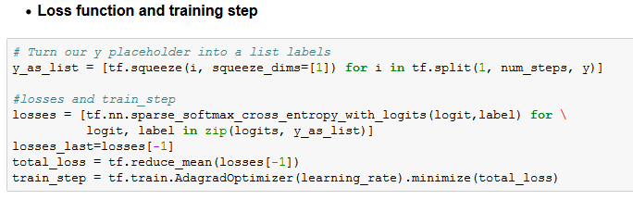

Slide 33
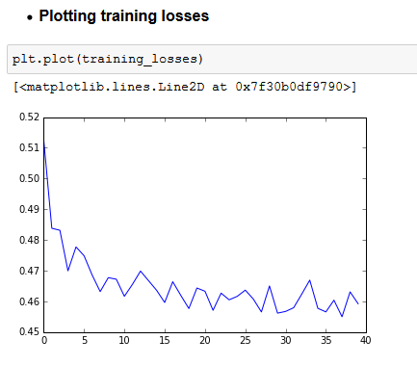
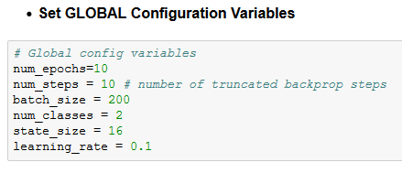
Understand your results

Slide 34
Now:
Translating our model to Tensorflow
Using a dynamic RNN
MSTC_RNN_2_dynamic.ipynb

Slide 35

Tensorflow RNN static vs. dynamic
Tensorflow contains two different functions for RNNs: tf.nn.rnn and tf.nn.dynamic_rnn.
Internally, tf.nn.rnn creates an unrolled static-graph for a fixed RNN length.
First, graph creation is slow.
Second, you’re unable to pass in longer sequences than you’ve originally specified.
tf.nn.dynamic_rnn solves this. It uses a tf.While loop to dynamically construct the graph when it is executed.
Graph creation is faster;
and you can feed batches of variable size.
What about performance? dynamic is faster?
In short, just use tf.nn.dynamic_rnn. There is no benefit to tf.nn.rnn and I wouldn’t be surprised if it was deprecated in the future.
http://www.wildml.com/2016/08/rnns-in-tensorflow-a-practical-guide-and-undocumented-features/

Slide 36
Tensorflow RNN static vs. dynamic
rnn_inputs are different
rnn_inputs to tf.nn.rnn is a list of tensors
rnn_inputs to tf.nn.dynamic_rnn is:
A Tensor with dimension
[batch_size, n_step, n_input]

Slide 37
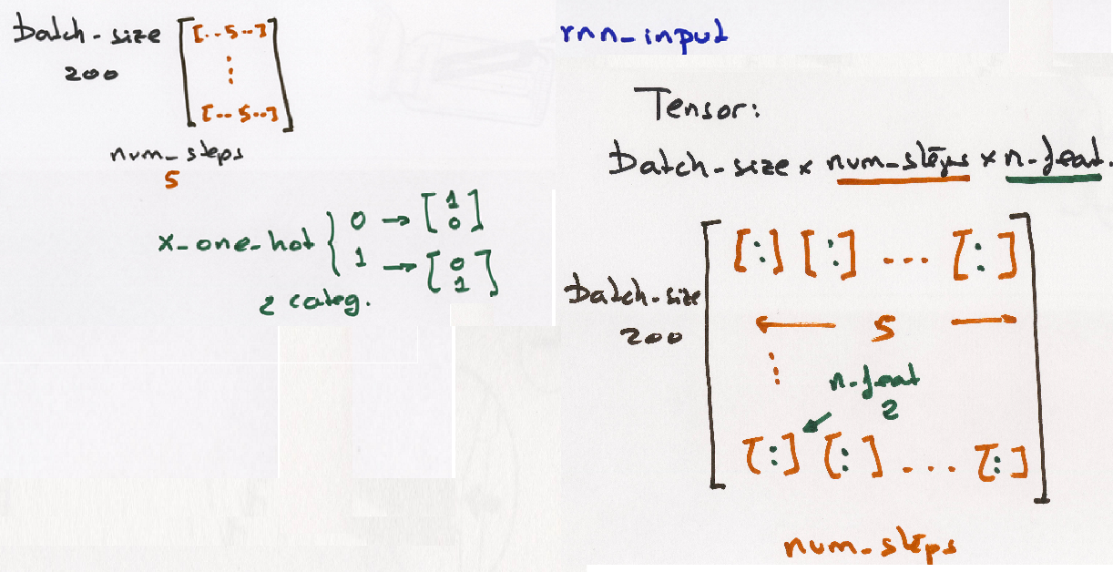
rnn_inputs to tf.nn.dynamic_rnn is:
A Tensor with dimension
[batch_size, n_step, n_input]
x
rnn_inputs = tf.one_hot(x, num_classes)

Slide 38
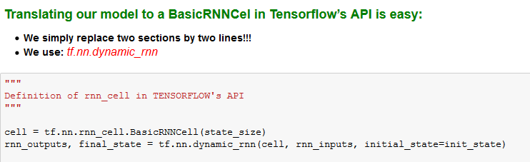

Slide 39
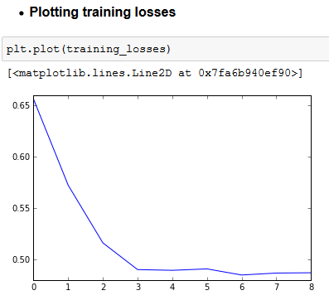
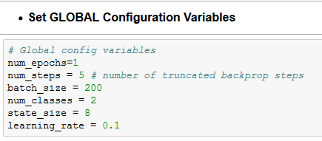
Understand your results

Slide 40
Finally:
We will use LSTM and GRU
For a Simple NLP Task:
character-level language model to generate character sequences
MSTC_RNN_3.ipynb
Simplified from:
http://r2rt.com/recurrent-neural-networks-in-tensorflow-ii.html

Slide 41
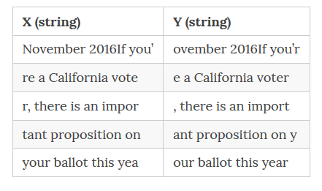
The NLP Task: language modeling to capture the statistical relationship among words / chars
The objective of the network is to observe the input x, one character at a time and produce the output sentence y, one character at a time
http://suriyadeepan.github.io/2017-02-13-unfolding-rnn-2/

Slide 42
Output sequence
……
$${y_{t−1}{ y}_{t} y}_{t+1}………$$
Input sequence
……
$${x_{t−1}{ x}_{t} x}_{t+1}………$$

Slide 43
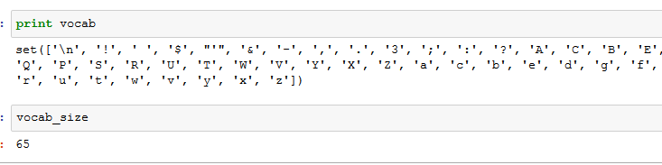
For this NLP Task:
We read a txt file: tinyshakespeare.txt , cervantes.txt
Read all characters = vocab and generating a mapping from chars to numbers vocab_to_idx and viceversa idx_to_vocab

Slide 44
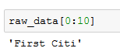
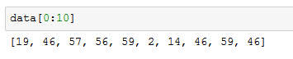
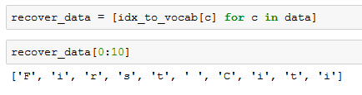
vocab_to_idx
idx_to_vocab

Slide 45
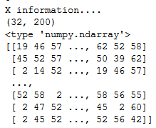
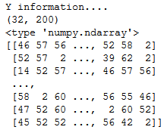
Epochs and Batches are generated in a similar way as in MSTC_RNN_1:
PTB_iterator from Penn Tree Bank (PTB) dataset is used
Example for: num_steps=200 batch_size=32

Slide 46
Embedings
Indices by themselves, carry no semantic meaning
This is where embedding comes in; more commonly known as word vector or word embedding.
http://sebastianruder.com/word-embeddings-1/

Slide 47
Embedings
In this case, we will
map the characters to low dimensional vectors of size state_size.
low-dimensional vector
(state_size = n_inputs)
http://sebastianruder.com/word-embeddings-1/

Slide 48
EMBEDDING LAYER
low-dimensional vector
GRU / LSTM
http://stackoverflow.com/questions/40184537/what-does-embedding-do-in-tensorflow

Slide 49
In this example embedings are done by:
creating an embedding matrix of shape
[ vocab_size=num_classes, state_size ]
and selecting a row of the matrix by index of character
embeddings = tf.get_variable('embedding_matrix', [num_classes, state_size])
# Note that our inputs are no longer a list, but a tensor of dims batch_size x num_steps x state_size we will use DYNAMIC RNN
rnn_inputs = tf.nn.embedding_lookup(embeddings, x)
http://sebastianruder.com/word-embeddings-1/

Slide 50
The embedding_matrix is a “layer” so Tensorflow does backprop of the error INTO this lookup table,
and hopefully what starts off as a randomly initialized dictionary will gradually become “significant”
EMBEDDING LAYER
low-dimensional vector
GRU / LSTM
http://stackoverflow.com/questions/40184537/what-does-embedding-do-in-tensorflow

Slide 51
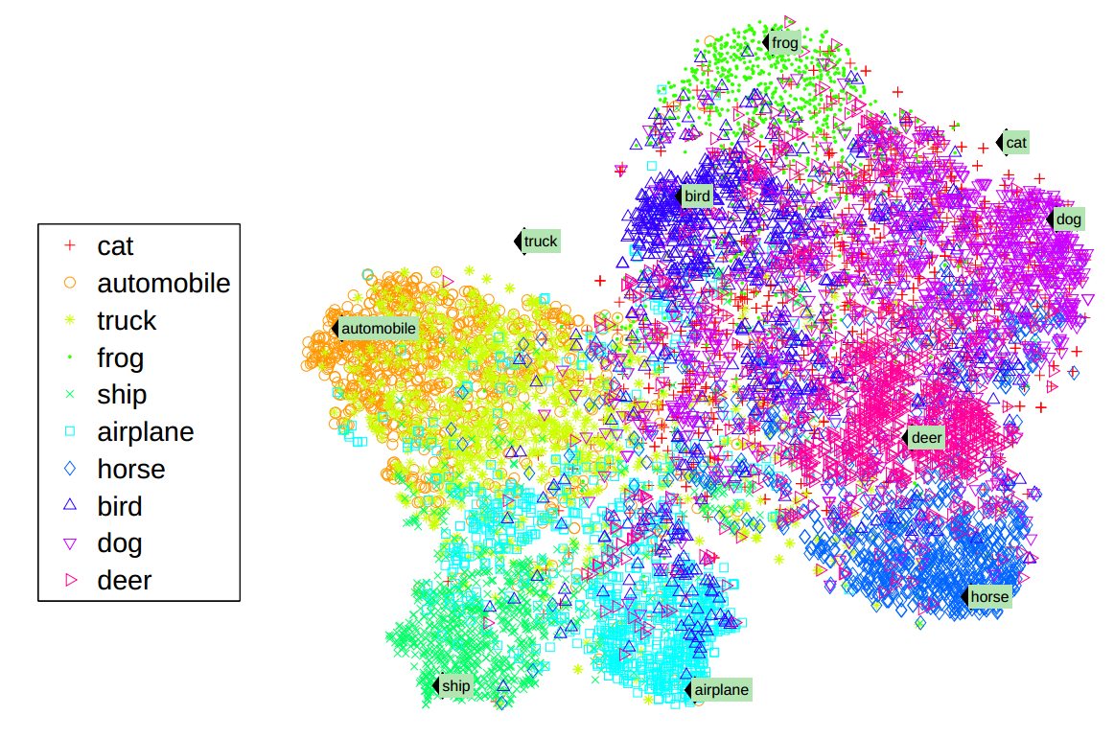
http://colah.github.io/posts/2014-07-NLP-RNNs-Representations/

Slide 52
See also:
Word2vec https://www.tensorflow.org/tutorials/word2vec
Vector space models (VSMs) represent (embed) words in a continuous vector space where semantically similar words are mapped to nearby points ('are embedded nearby each other')

Slide 53
Now we can test using LSTM:
#LSTM
cell = tf.nn.rnn_cell.LSTMCell(state_size, state_is_tuple=True)
cell = tf.nn.rnn_cell.MultiRNNCell([cell] * num_layers, state_is_tuple=True)
or GRU
# GRU
cell = tf.nn.rnn_cell.GRUCell(state_size)

Slide 54
Now we can test using LSTM or GRU
+ much more to consider…
#Dropout
# Regularization
# Batch normalization
# Adding noise…

Slide 55
Models LSTM or GRU can be saved:
saver = tf.train.Saver()
saver.save(sess, 'RNN_GRU_model_shakespeare')

Slide 56
Models LSTM or GRU can be used to generate TEXT
NOTE that for this we need to rebuild the graph so as to accept a single character at a time

Slide 57
A se dije a su la caral mar entus de la mucho al disto escundas el maloras de sus entre de su como lo haballe que de sin cuanto en llaba en el muestra me camiminor las, coralas des como ello, que estroras de esprento, y asigo, podros compastra de aquellao es a todo de lo que a sercido al vene de la contuento entaron esa camo, separ en esta estusando a lo hallar de su amo, y con la alvando.
Y le caballero, que lleguado al por el mano, a su por mas quiero a toda el pocina dejor la porte en serventar a la cual de algún estar en alguna dejuna me de ella embro que se le cabrese las ma

Slide 58
Basic concepts: LSTM & GRU
http://colah.github.io/posts/2015-08-Understanding-LSTMs/
Vanishing gradients: a problem?
it may be that for some tasks we want gradients to vanish completely, and for others, it may be that we want them to grow
Are RNNs capable of handling “long-term dependencies?”
Long Short Term Memory networks – LSTMs
Hocreiter and Schmidhuber (1997)

Slide 59


$$NOTATION: states= h_{t}$$
The repeating module in a standard RNN contains a single layer

Slide 60

The repeating module in LSTM contains four interacting layers

Slide 61




Core Idea Behind LSTM
CELL STATE $= c_{t}$
$$states= h_{t}$$

Slide 62

Tensorflow NOTE:
cell = tf.nn.rnn_cell.LSTMCell(state_size, state_is_tuple=True)
“Hidden State"$h_{t}$ and "Cell State" ,$C_{t}$

Slide 63

Core Idea Behind LSTM
The LSTM does have the ability to remove or add information to the cell state, carefully regulated by structures called gates.
Gates are a way to optionally let information through.
They are composed out of a sigmoid neural net layer and a pointwise multiplication operation.
A value of zero means “let nothing through,” while a value of one means “let everything through!”
An LSTM has three of these gates, to protect and control the cell state

Slide 64
Basic concepts: LSTM & GRU
Hocreiter and Schmidhuber (1997)
The fundamental principle of LSTMs: to ensure the integrity of our messages in the real world, we write them down
The fundamental challenge of LSTMs and keeping our state under control is to be selective in three things:
what we write (write selectivity),
what we read (because we need to read something to know what to write) (read selectivity)
and what we forget (because obsolete information is a distraction and should be forgotten) (forget selectivity)
Gates as a mechanism for selectivity

Slide 65

Step-by-Step LSTM Walk Through
Forget gate: The first step in our LSTM is to decide what information we’re going to throw away from the cell state.
When we “see” something new relevant we decide forget….

Slide 66


Step-by-Step LSTM Walk Through
The next step is to decide what new information we’re going to store in the cell state. This has two parts.
First, a sigmoid layer called the “input gate layer” decides which values we’ll update.
Next, a tanh layer creates a vector of new candidate values, $\tilde{C_{t}}$, that could be added to the state.

Slide 67


Step-by-Step LSTM Walk Through
It’s now time to update the old cell state,$C_{t−1}$, into the new cell state $C_{t}$
The previous steps already decided what to do, we just need to actually do it.
We multiply the old state by $f_{t}$(forget gate) then we add $i_{t}∗{\tilde{C}}_{t}$

Slide 68


Step-by-Step LSTM Walk Through
Finally, we need to decide what we’re going to output $h_{t}$. This output will be based on our cell state, but will be a filtered version.
First, we run a sigmoid layer which decides what parts of the cell state we’re going to output.
Then, we put the cell state through tanh (to push the values to be between −1 and 1) and multiply it by the output of the sigmoid gate, so that we only output the parts we decided to.

Slide 69

Variants on Long Short Term Memory
One popular LSTM variant, introduced by Gers & Schmidhuber (2000), is adding “peephole connections.”
This means that we let the gate layers look at the cell state.
The above diagram adds peepholes to all the gates, but many papers will give some peepholes and not others.

Slide 70

Variants on Long Short Term Memory
Another variation is to use coupled forget and input gates.
We only input new values to the state when we forget something older

Slide 71

Variants on Long Short Term Memory
Gated Recurrent Unit, or GRU, introduced by Cho, et al. (2014).
It combines the forget and input gates into a single “update gate.”
It also merges the cell state and hidden state, and makes some other changes.
The resulting model is simpler than standard LSTM models, and has been growing increasingly popular.

Slide 72

Variants on Long Short Term Memory
These are only a few of the most notable LSTM variants.
See for example: BLSTM Bi-directional LSTM

Slide 73
Variants on Long Short Term Memory
Which of these variants is best? Do the differences matter?
Greff, et al. (2015) do a nice comparison of popular variants, finding that they’re all about the same.
Jozefowicz, et al. (2015) tested more than ten thousand RNN architectures, finding some that worked better than LSTMs on certain tasks.

Slide 74


TensorBoard: Visualizing Learning

Slide 75

https://keras.io/
Scikit Flow
http://terrytangyuan.github.io/2016/03/14/scikit-flow-intro/

Slide 76
References (I)
https://theneuralperspective.com/2016/10/04/05-recurrent-neural-networks-rnn-part-1-basic-rnn-char-rnn/
http://colah.github.io/posts/2015-08-Understanding-LSTMs/
http://www.wildml.com/2015/09/recurrent-neural-networks-tutorial-part-2-implementing-a-language-model-rnn-with-python-numpy-and-theano/
https://github.com/suriyadeepan/rnn-from-scratch
http://stats.stackexchange.com/questions/241985/understanding-lstm-units-vs-cells
http://monik.in/a-noobs-guide-to-implementing-rnn-lstm-using-tensorflow/
https://medium.com/@erikhallstrm/hello-world-rnn-83cd7105b767
http://suriyadeepan.github.io/2017-01-07-unfolding-rnn/
http://archive.eetindia.co.in/www.eetindia.co.in/VIDEO_DETAILS_700001601.HTM

Slide 77
References (I)
http://r2rt.com/styles-of-truncated-backpropagation.html
http://akkikiki.github.io/assets/LSTM+and+GRU.html
http://campuspress.yale.edu/yw355/deep_learning/
http://datascience.stackexchange.com/questions/12964/what-is-the-meaning-of-the-number-of-units-in-the-lstm-cell
http://stackoverflow.com/questions/37901047/what-is-num-units-in-tensorflow-basiclstmcell

